Slide 1
Instructional Design Overview
Assignment 1
Stephanie Scaletta EDLD 5318

Slide 2
CONTENTS OF THIS OVERVIEW
01
02
03
04
DESIGN OVERVIEW
INSTRUCTIONAL FORMAT
INSTRUCTIONAL DESIGN
INSTRUCTIONAL DOCUMENTS & RESOURCES

Slide 3
DESIGN OVERVIEW
I am designing a 9 week course for Career and Technology Education Teachers.
My intended audience is all CTE instructors, ranging from a wide variety of teaching experiences, and CTE coordinators and instructional leaders.
The focus of this course is to strengthen CTE collaboration models with PLCs, Cross-Pathway Planning and Mentorships.
I intend to use Canvas as my Learning Management System.

Slide 4
GOALS & OUTCOMES
BHAG: Empower every CTE teacher to lead transformative, industry connected learning by building a culture of sustainable collaboration that drives innovation, elevates student outcomes, and redefines professional learning as a teacher-led movement.
Learning Outcome: By the end of this course, participants will be able to design, implement and facilitate a sustainable collaborative model tailored to their program.

Slide 5
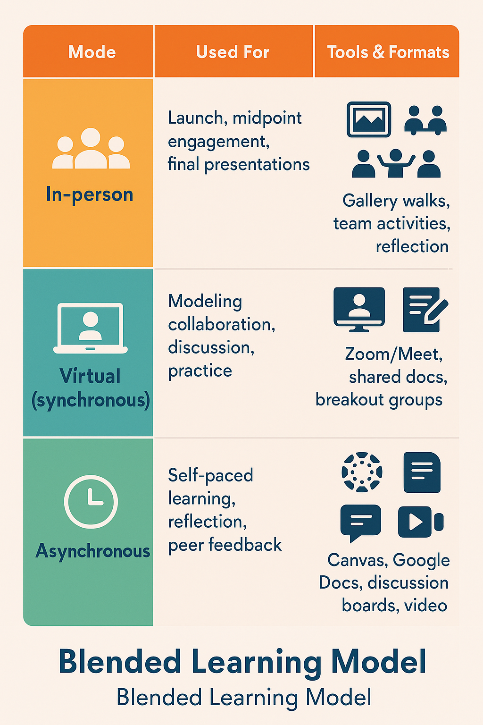


INSTRUCTIONAL FORMAT
This course will be blended learning. I will utilize online, asynchronous instruction and in-person, teacher led coaching.
CSLE
Harapunik, D. (2018) 4 Keys to CSLE+COVA [Video]
https://www.youtube.com/watch?v=9fQTesktinM&t=102s

Slide 6
INSTRUCTIONAL DESIGN
This course is primarily outcomes based, with competency-based elements embedded within.
Outcome Based Education: Learning is aligned to broad, transformative goals and measured through authentic tasks.
Competency Based Education: Teachers demonstrate specific, practical skills and performance tasks aligned to their professional context.

Slide 7
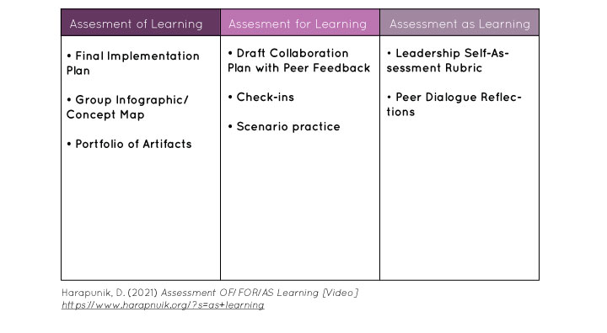
INSTRUCTIONAL DESIGN

Slide 8
INSTRUCTIONAL DOCUMENTS
Documents I have already created are the Alignment of Goals, Activities and Assessment with the 3 column table.
Course Outline
Instructional Document material that I am currently working on creating are:
Syllabus
Course Materials & Resources
LMS organization plan
Introduction to the course video

Slide 9
REFERENCES
Fink, L.D. (2003) A self-directed guide to designing courses for significant learning. University of Oklahoma
https://www.bu.edu/sph/files/2014/03/www.deefinkandassociates.com_GuidetoCourseDesignAug05.pdf
Harapunik, D. (2018) 4 Keys to CSLE+COVA [Video]
https://www.youtube.com/watch?v=9fQTesktinM&t=102s
Harapunik, D. (2021) Assessment OF/FOR/AS Learning [Video]
https://www.harapnuik.org/?s=as+learning
Morrison, D. (2013, May 7). Why Online Courses [Really] Need an Instructional Design Strategy. https://onlinelearninginsights.wordpress.com/2013/05/07/why-online-courses-really-need-an-instructional-design-strategy/

